Slide 1
Mapping the creative industries in Mexico DENUE data
Juan Mateos-Garcia
Taller de arranque: Mapa Creativo Transmedia México
8 – 9 Febrero
Ciudad de México

Slide 2
Structure
Questions, concepts and data
The DENUE data
What is DENUE?
Measuring the creative industries in DENUE
Mapping
Contact details
Conclusions and next steps

Slide 3
Policy context (UK, perhaps other countries too?)
Creative industries perceived as a potential motor of growth: human capital intensive, export intensive, jobs resilient to automation, make other industries more productive <- Ministries of Industry and Economics love this
We know that space is very important for innovation and creativity: phenomenon of creative clusters and creative cities.
Unique local contexts
Need support ecosystems
Negative side effects? (economic and geographic inequality)
We need the right data to understand all the above and support with effective policies. National pictures are not enough, we need to map!

Slide 4
Questions, concepts and data
Some concepts that inform our analysis:
Clustering: economic activity in many sectors tends to concentrate geographically.
Specialisation: Some sectors tend to be over-represented in a location
Agglomeration economies: Clustering of companies inside a sector generates economic advantages for the companies based in a location.
Urbanisation economies: Clustering of companies in different sectors generates advantages for the companies in a location, and makes the location more resilient and innovative.

Slide 5
Questions, concepts and data
DENUE
Where are the Mexican creative industries?
What are their innovation activities and barriers to growth?
Meetup
Survey
How are they connected with each other?
Better evidence base to understand & support the sector

Slide 6
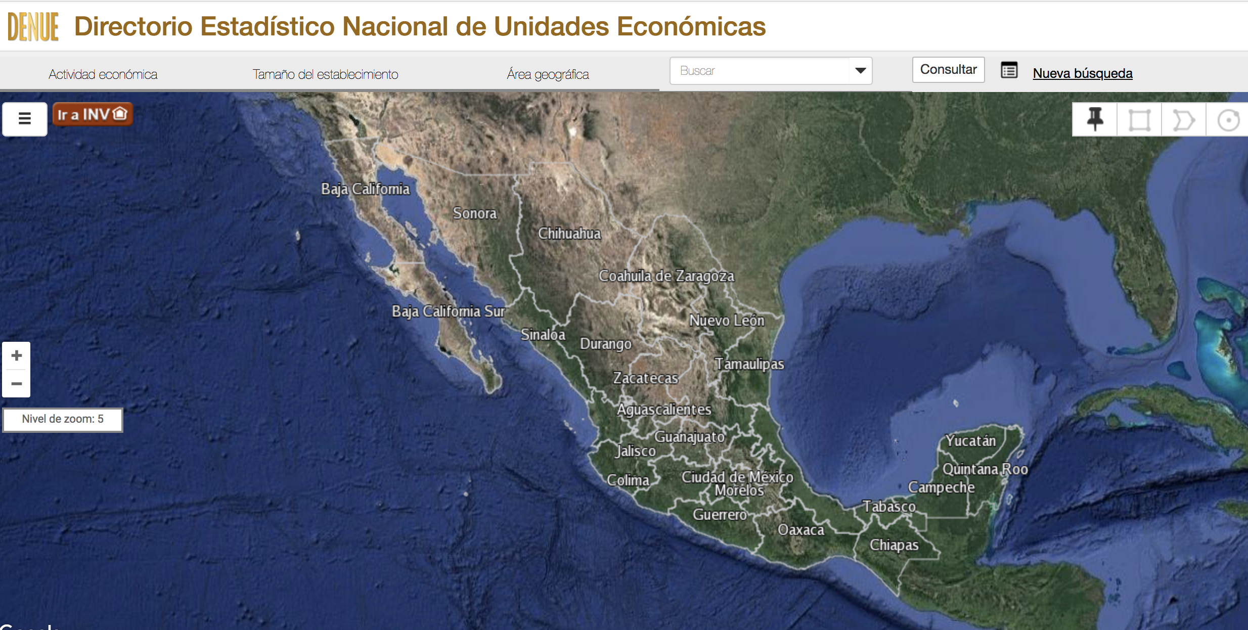
2. What is DENUE?

Slide 7
2. What is DENUE?
Directorio Estadístico Nacional de Unidades Económicas
An administrative register with information about ~5m economic units in México. Started in 2010, latest update in 2016
Name
Sector
Size
Address

Slide 8
2. Defining and measuring the creative industries (in DENUE)
UK DCMS definition of creative industries: Those industries which have their origin in individual creativity, skill and talent and which have a potential for wealth and job creation through the generation and exploitation of intellectual property
From definitions to measurements: Nesta (2013) and DCMS (2014) identified a set of industries with high creative intensity (propensity to employ workers in creative occupations). They are: Advertising and Marketing, Architecture, Crafts, Design, Film, Radio and TV, Libraries and Museums, Music and performing arts, Publishing, and Software.
From the UK to North America and México: We draw on Nesta (2016) to translate UK industry codes to those used in DENUE.

Slide 9
2. Defining and measuring the creative industries in DENUE
Advertising and Marketing
Architecture
Crafts
Design
Film, Radio and TV
Libraries and Museums
Music and performing arts
Publishing
Software
Excludes freelancers, ONGs, not-for-profits
Doesn’t include some sectors with important cultural components: tourism, leisure...
DCMS / Nesta definition
Creative NAICS
DENUE
Creative industries

Slide 10
2. Defining and measuring the creative industries in DENUE
I have explored two creative industries operational NAICs definitions
Nesta’s 2016, and a more refined one drawing on the higher detail of DENUE NAICS.
The results are different
In what follows I use Nesta’s definition for consistency...
But we need to agree this!

Slide 11
2. Defining and measuring the creative industries in DENUE
There are also some differences with the satellite accounts (Sas)
In sector rankings and total sizes.
A preliminary estimate suggests ~ 700,000 in DENUE vs. ~1m according to SAccs.
But...
25% of SAs is home production
DENUE data is right censored (we are underestimating the sizes of the largest companies)
Still...
Cultural industries = 2.5% total employment Mexico (INEGI)
Creative industries = 2.5% estimated employment DENUE !!

Slide 12
2. Defining and measuring the creative industries in DENUE
Media / digital / creative services have more large companies. We are probably underestimating their size.
On average, creative industries tend to have bigger sizes than the economy overall. Do we want to compare with specific sectors?

Slide 13
2. Defining and measuring the creative industries in DENUE
What about age? Hard to measure with the data we have (which captures incorporation into DENUE rather than company incorporation) but what we have suggests more Software, Advertising, Film and architecture companies incorporated recently.

Slide 14
2. Mapping the creative industries in Mexico
We can map the data at different levels of detail: states, municipalities, something even more detailed...
For now we focus on state totals.
Mexico DF has:
15% of creative businesses in DENUE
27% of employment (estimated, probably more if we captured large companies accurately)

Slide 15
2. Mapping the creative industries in Mexico
Creative activity tends to concentrate more than other sectors, specially in terms of employment. 40% of employment in Software, and >25% publishing and design in the top state (DF)

Slide 16
2. Mapping the creative industries in Mexico
Clustering is about specialisation. We do that by sector and state below. As we saw before employment is much more concentrated than businesses.
Some interesting patterns:
Film, Radio & TV in North Mexico
Creative Services in Nuevo León
Music & Performing Arts towards the South
Crafts in Durango and Guerrero

Slide 17
2. Mapping the creative industries in Mexico
What creative sectors tend to be found in the same places? Co-location could suggest value-chain linkages and knowledge/creative spillovers between them
Very strong business and employment co-location of creative, commercial services
Also some co-location of content businesses but not as strong
Libraries and Museums and Crafts tend to be locate in different states from other creative sectors

Slide 18
Availability of contact details (for survey implementation)
Addresses available for almost everyone
Telephone numbers more available than emails
Better contact detail availability in central states (Nueva León, Aguascalientes, DF) and North (maybe driven by sectoral composition?)

Slide 19
Availability of contact details (for survey implementation)
Several states have good telephone coverage for many sectors...although they won’t necessarily represent those sectors well (i.e. crafts in Urban areas). Email coverage is generally patchy excepting some creative services

Slide 20
Conclusions and next steps
Nice dataset and interesting findings even in this exploratory phase!
Some echoes of UK findings around concentration and co-location
Differences with Satellite Accounts linked to differences in definitions and sources.
Missing data means we can’t currently use the data to generate employment estimates... do we want to?
Other interesting ecosystems outside DF we could explore?
Telephone survey appears feasible for some states/sectors
Next steps
Consider temporal dimension with previous DENUE snapshots
Perform analysis at the municipality level?

Slide 21
Juan.mateos-garcia@nesta.org.uk
@jmateosgarcia

